Slide 1
Cloud Computing
SEWP ZG527

Slide 2
Agenda
Virtualization Techniques and Types
Introduction to Virtualization
Use & demerits of Virtualization
Types of Virtualization
- Examples
x86 Hardware Virtualization
2

Slide 3
Technology made cloud possible
Key Technology is Virtualization
App
App
App
App
App
App
OS
OS
OS
Operating System
Hypervisor
Hardware
Hardware
Traditional Stack
Virtualized Stack
Virtualization plays an important role as an enabling technology for datacentre implementation by abstracting compute, network, and storage service platforms from the underlying physical hardware
Notes:
RL 2.1
Virtualization is simulating a hardware platform, operating system, storage device or network resources

Slide 4
Importance of Virtualization in
Cloud Computing
Cloud can exist without Virtualization, although it will be difficult and inefficient.
Cloud makes notion of “Pay for what you use”, “infinite availability- use as much you want”.
These notions are practical only if we have
lot of flexibility
efficiency in the back-end.
This efficiency is readily available in Virtualized Environments and Machines

Slide 5
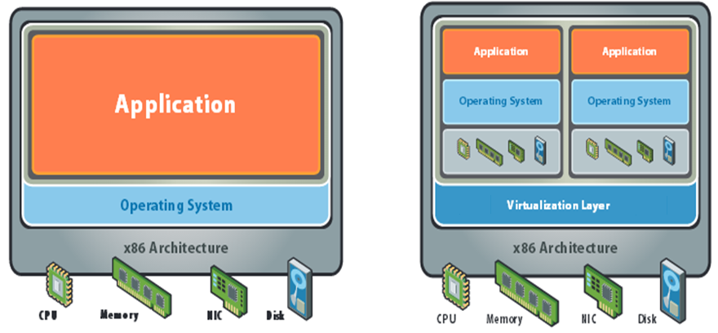
What is Virtualization

Slide 6
What does Virtualization do?
Virtualization allows multiple operating system instances to run concurrently on a single computer
It is a means of separating hardware from a single operating system.
Each “guest” OS is managed by a Virtual Machine Monitor (VMM), also known as a hypervisor.
Because the virtualization system sits between the guest and the hardware, it can control the guests’ use of CPU, memory, and storage, even allowing a guest OS to migrate from one machine to another.
Instead of purchasing and maintaining an entire computer for one application, each application can be given its own operating system, and all those operating systems can reside on a single piece of hardware.
Virtualization allows an operator to control a guest operating system’s use of CPU, memory, storage, and other resources, so each guest receives only the resources that it needs.

Slide 7
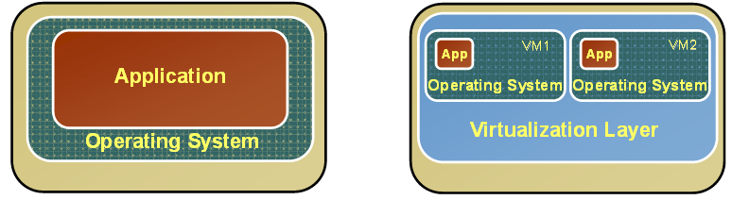
Changes after Virtualization
Before Virtualization
After Virtualization
Single OS image per machine
Software and hardware tightly coupled
Running multiple applications on same machine often creates conflict
Underutilized resources
Inflexible and costly infrastructure
• Hardware-independence of operating system and applications
• Virtual machines can be provisioned to any system
• Can manage OS and application as a single unit by encapsulating them into virtual machines

Slide 8
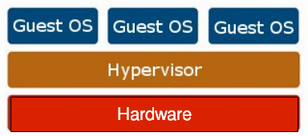
Virtualization Architecture
OS assumes complete control of the underlying hardware.
Virtualization architecture provides this illusion through a hypervisor/VMM.
Hypervisor/VMM is a software layer which:
Allows multiple Guest OS (Virtual Machines) to run simultaneously on a single physical host
Provides hardware abstraction to the running Guest OSs and efficiently multiplexes underlying hardware resources

Slide 9
Cloud Computing
SEWP ZG527

Slide 10
Agenda
Virtualization Techniques and Types
Introduction to Virtualization
Use & demerits of Virtualization
Types of Virtualization
- Examples
x86 Hardware Virtualization
2

Slide 11
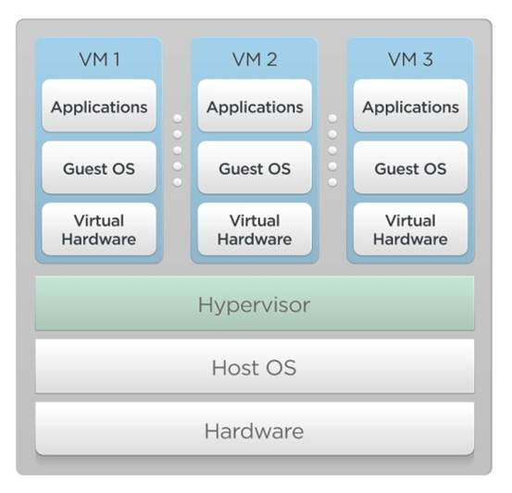
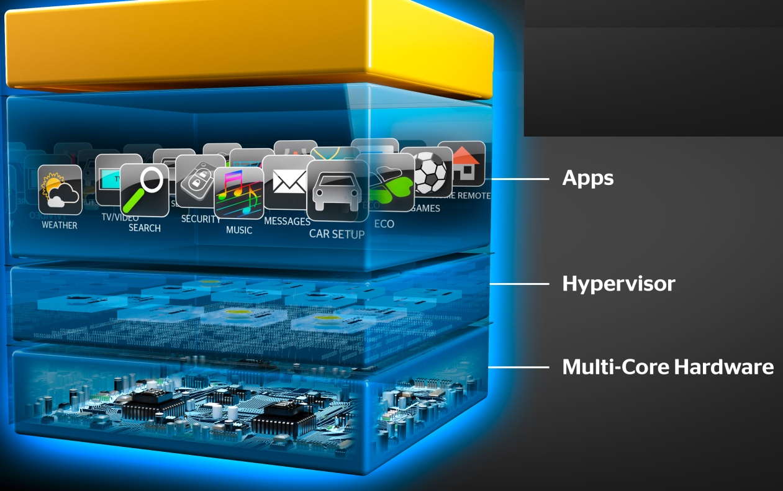
Hypervisor
A thin layer of software that generally provides virtual partitioning capabilities which runs directly on hardware, but underneath higher-level virtualization services. Sometimes referred to as a “bare metal” approach.
Notes:
RL 2.2

Slide 12
Terminologies to remember
Virtualization – System and Process
VMM or Hypervisor
Guest or Virtual machine – Application + OS
Multi-tenancy, Concurrency

Slide 13
Hypervisor Design Goals
Isolation
Security isolation
Fault isolation
Resource isolation
Reliability
Minimal code base
Strictly layered design
Not extensible
Scalability
Scale to large number of cores
Large memory systems

Slide 14
How Hypervisor goals are achieved?
Partitioning Kernel
“Partition” is isolation boundary
Few virtualization functions; relies on virtualization stack
Very thin layer of software
Microkernel
Highly reliable
Basis for smaller Trusted Computing Base (TCB)
No device drivers
Drivers run in a partition
Well-defined interface
Allow others to create support for their OSes as guests

Slide 15
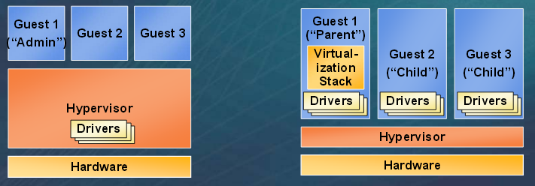
Hypervisor
Monolithic versus Microkernelized
Monolithic hypervisor
Simpler than a modern kernel, but still complex
Contains its own drivers model
Microkernelized hypervisor
Simple partitioning functionality
Increase reliability and minimize lowest level of the TCB
No third-party code
Drivers run within guests

Slide 16
Terminologies to remember
Types of Hypervisors – Bare metal or native – VMWare ESX
Hosted hypervisors – VMWare GSX
Hybrid hypervisors – MS Hyper-V, Xen

Slide 17
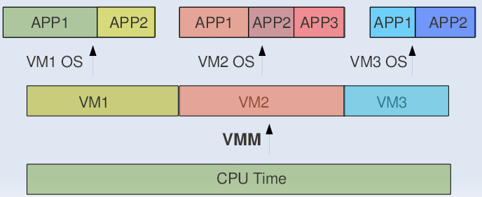
CPU Sharing
VMM or Hypervisor provides a virtual view of CPU to VMs.
In multi processing, CPU is alloted to the different processes in form of time slices by the OS.
Similarly VMM or Hypervisor allots CPU to different VMs.

Slide 18
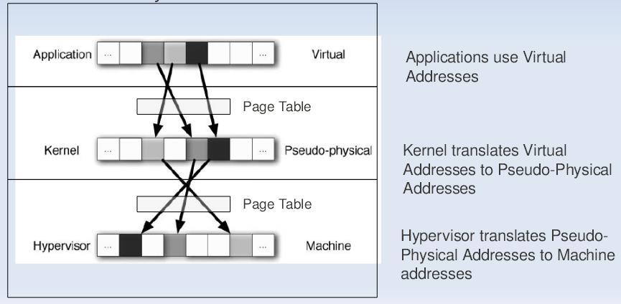
Memory Sharing
In Multiprogramming there is a single level of indirection maintained by Kernel.
In case of Virtual Machines there is one more level of indirection maintained by VMM

Slide 19
IO Sharing
Device needs to use Physical Memory location.
In a virtualized environment, the kernel is running in a hypervisor-provided virtual address space
Allowing the guest kernel to convey an arbitrary location to device for writing is a serious security hole
Each device defines its own protocol for talking to drivers

Slide 20
Thanks!!!
Queries?

Slide 21
Cloud Computing
SEWP ZG527

Slide 22
Agenda
Virtualization Techniques and Types
Introduction to Virtualization
Use & demerits of Virtualization
Types of Virtualization
- Examples
x86 Hardware Virtualization
2

Slide 23
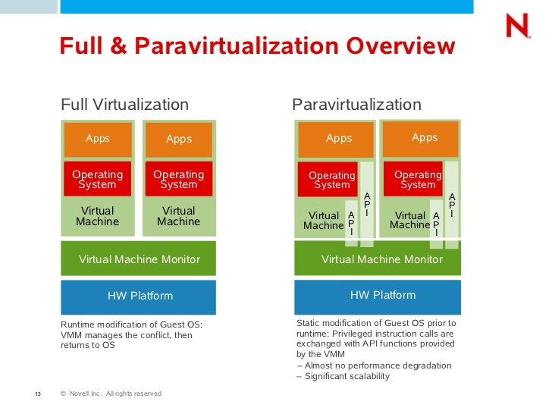
Approaches for Virtualization
Notes:
RL 2.3

Slide 24
Full Virtualization
Full virtualization
In its basic form known as “full virtualization” the hypervisor provides a fully emulated machine in which an operating system can run. VMWare is a good example.
The biggest advantage to this approach is its flexibility: one could run a RISC-based OS as a guest on an Intel-based host.
While this is an obvious approach, there are significant performance problems in trying to emulate a complete set of hardware in software.

Slide 25
ParaVirtualization
Paravirtualization
“Paravirtualization,” found in the XenSource, open source Xen product, attempts to reconcile these two approaches. Instead of emulating hardware, paravirtualization uses slightly altered versions of the operating system which allows access to the hardware resources directly as managed by the hypervisor.
This is known as hardware-assisted virtualization, and improves performance significantly.
In order to retain flexibility, the guest OS is not tied to its host OS. Drastically different operating systems can be running in a hypervisor at the same time, just as they can under full virtualization.
In this way, paravirtualization can be thought of as a low-overhead full virtualization

Slide 26
SKI Virtualization
Single Kernel Image (SKI),
Single Kernel Image (SKI), in which the host OS spawns additional copies of itself. This kind of virtualization can be found in Swsoft Virtuozzo and Sun Solaris, Zones. SKI can be thought of as “lightweight” virtualization.
While this approach avoids the performance problems with pure emulation, it does so at the expense of flexibility.
It is not possible, for instance, to run different versions or even different patch levels of a particular operating system on the same machine.
Whatever versions exist in the host, that same software will be provided in the guest. SKI also sacrifices the security and reliability provided by other virtualization methods.

Slide 27
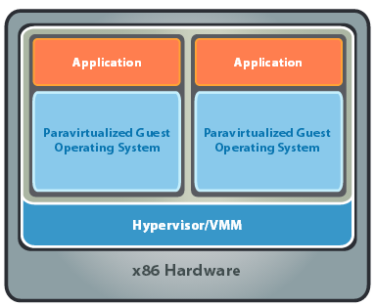
x86 Hardware Virtualization
The latest generation of x86-based systems feature processors with 64-bit extensions supporting very large memory capacities.
This enhances their ability to host large, memory-intensive applications, as well as allowing many more virtual machines to be hosted by a physical server deployed within a virtual infra-structure.
The continual decrease in memory costs will further accelerate this trend.

Slide 28
x86 Hardware Virtualization
For Industry-standard x86 systems, the two approaches typically used with software-based partitioning are
hosted and
hypervisor architectures
A hosted approach provides partitioning services on top of a standard operating system and supports the broadest range of hardware configurations.
In contrast, a hypervisor architecture is the layer of software installed on a clean x86-based system (hence it is often referred to as a “bare metal” approach). Since it has direct access to the hardware resources, a hypervisor is more efficient than hosted architectures, enabling greater scalability, robustness and performance

Slide 29
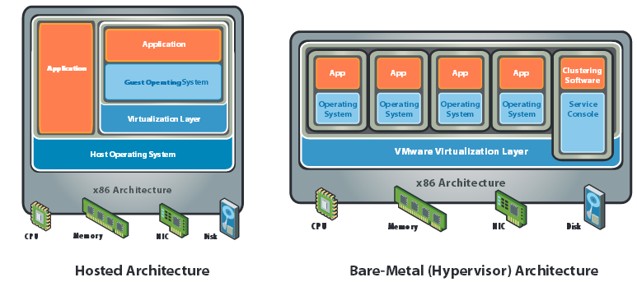
x86 Hardware Virtualization

Slide 30
Terminologies to remember
Basic technique of virtualization is – Trap and Emulate Virtualization
Privilege levels or protection ring
CPL – Current Privilege Level (Guest OS)
Instruction Types – Behavior sensitive, Control sensitive
Control sensitive (privileged instructions)
Method of virtualization – Binary Translation
Para virtualization (Hypervisor dependent)

Slide 31
Advantages of Virtualization
Instant provisioning - fast scalability
Live Migration is possible
Load balancing and consolidation in a Data Center is possible.
Low downtime for maintenance
Virtual hardware supports legacy operating systems efficiently
Security and fault isolation

Slide 32
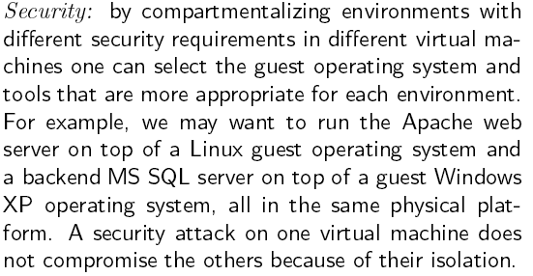
Advantages of Virtualization

Slide 33
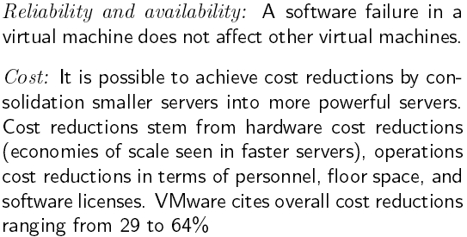
Advantages of Virtualization

Slide 34
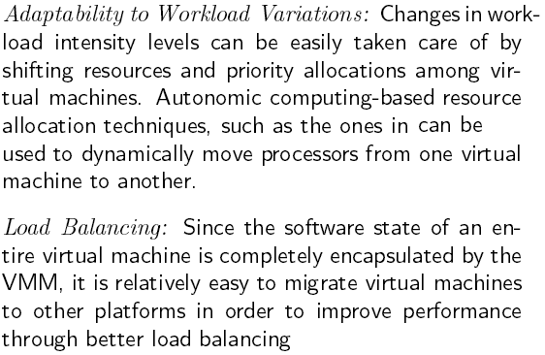
Advantages of Virtualization

Slide 35
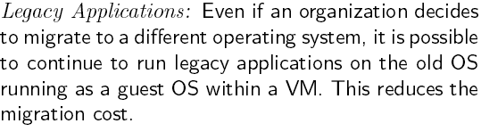
Advantages of Virtualization

Slide 36
Issues to be aware of
Software licensing
One of the most significant virtualization-related issues to be aware of is software licensing. Virtualization makes it easy to create new servers, but each VM requires its own separate software license. Organizations using expensive licensed applications could end up paying large amounts in license fees if they do not control their server sprawl.
IT training
IT staff used to dealing with physical systems will need a certain amount of training in virtualization. Such training is essential to enable the staff to debug and troubleshoot issues in the virtual environment, to secure and manage VMs, and to effectively plan for capacity.
Hardware investment
Server virtualization is most effective when powerful physical machines are used to host several VMs. This means that organizations that have existing not-so-powerful hardware might still need to make upfront investments in acquiring new physical servers to harvest the benefits of virtualization

Slide 37
Issues to be aware of
Performance can be a concern, especially for in-band deployments, where the virtualization controller or appliance can become a bandwidth bottleneck.
Interoperability among vendor products is still evolving.
Failure of the virtualization device, leading to loss of the mapping table.

Slide 38
Applications of Virtualization
Today, virtualization can apply to a range of system layers, including hardware-level virtualization, operating system-level virtualization, and high-level language virtual machines.
Maximize resources — Virtualization can reduce the number of physical systems you need to acquire, and you can get more value out of the servers. Most traditionally built systems are underutilized. Virtualization allows maximum use of the hardware investment.
Multiple systems — With virtualization, you can also run multiple types of applications and even run different OS for those applications on the same physical hardware.
IT budget integration — When you use virtualization, management, administration and all the attendant requirements of managing your own infrastructure remain a direct cost of your IT operation.

Slide 39
Technology Trends
Virtualization is Key to Exploiting Trends
Allows most efficient use of the compute resources
Few apps take advantage of 16+ CPUs and huge memory as well as virtualization
Virtualization layer worries about NUMA, not apps
Maximize performance per watt across all servers
Run VMs on minimal # of servers, shutting off the others
Automated, live migration critical:
Provide performance guarantees for dynamic workloads
Balance load to minimize number of active servers
Stateless, Run-anywhere Capabilities
Shared network and storage allows flexible mappings
Enables additional availability guarantees

Slide 40
Thanks!!!
Queries?

Slide 41
Cloud Computing
SEWP ZG527

Slide 42
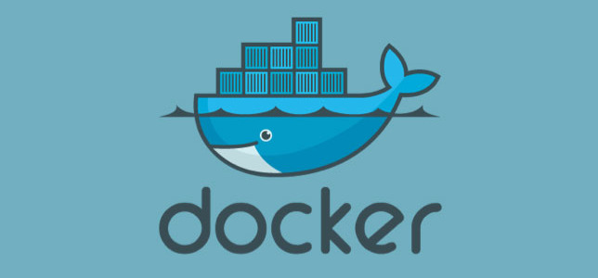
Notes:
RL 2.4

Slide 43
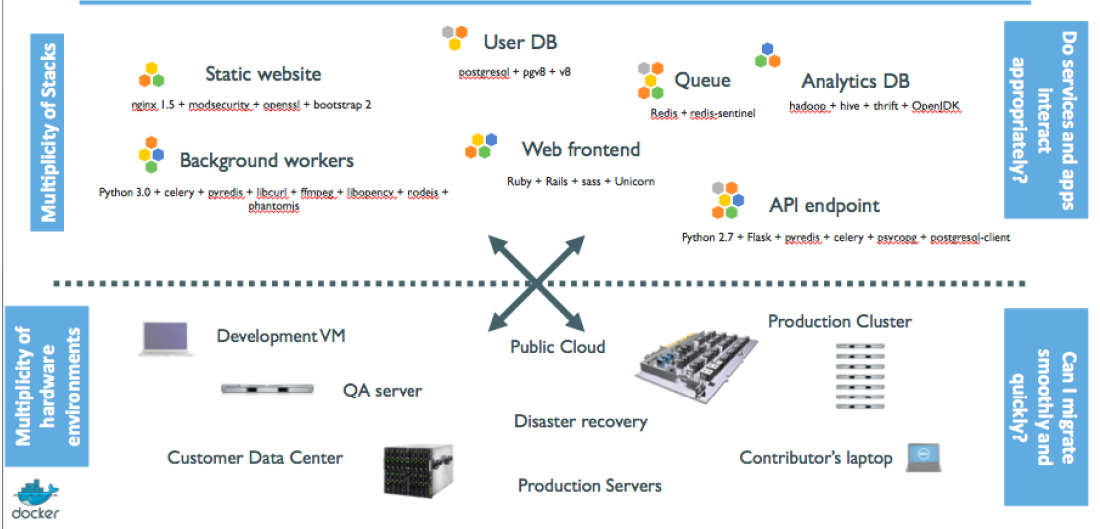
Current Problem the Industry is facing

Slide 44
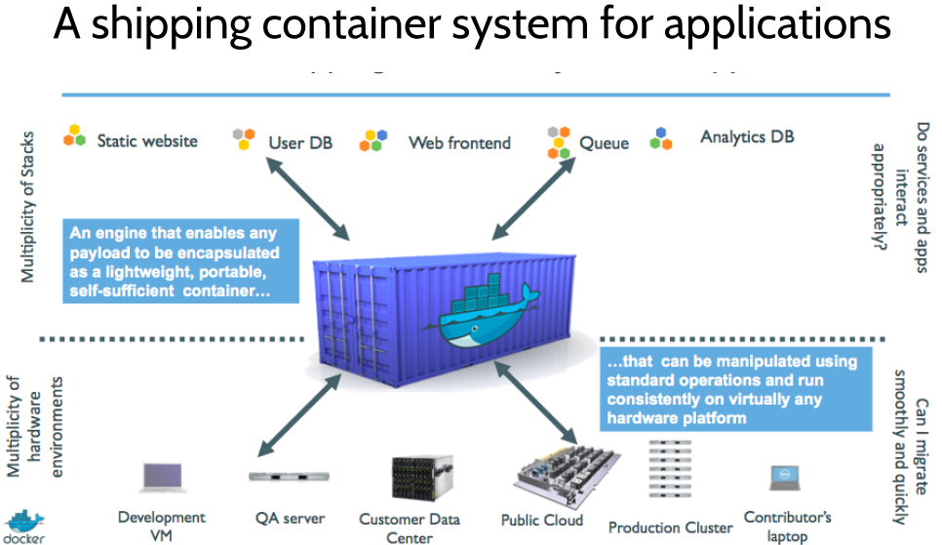

Slide 45

Dockers
All applications have their own dependencies, which include both software and hardware resources.
Docker is a mechanism that helps in isolating the dependencies per each application by packing them into containers.
In terms of technology, it provides cloud portability by running the same applications in different virtual environments.
Containers are scalable and safer to use and deploy as compared to regular approaches.

Slide 46
Virtual Machines
Virtual machines are used extensively in cloud computing.
Isolation and resource control have continually been achieved through the use of virtual machines.
Virtual machine loads a full OS with its own memory management and enable applications to be more efficient and secure while ensuring their high availability.
App
App
App
App
App
App
OS
OS
OS
Operating System
Hypervisor
Hardware
Hardware
Traditional Stack
Virtualized Stack

Slide 47
How are Docker Containers different from a Virtual Machine?
Virtual machines have a full OS with its own memory management installed with the associated overhead of virtual device drivers.
Docker containers are executed with the Docker engine rather than the hypervisor.
Containers are therefore smaller than Virtual Machines and enable faster start up with better performance, less isolation and greater compatibility possible due to sharing of the host’s kernel.

Slide 48
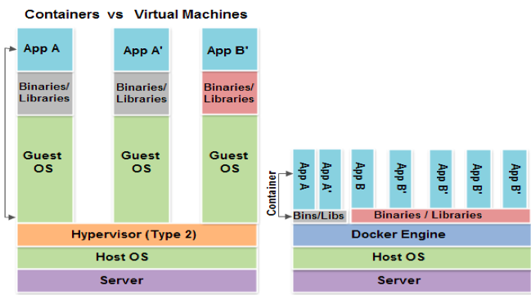
How are Docker Containers different from a Virtual Machine?

Slide 49
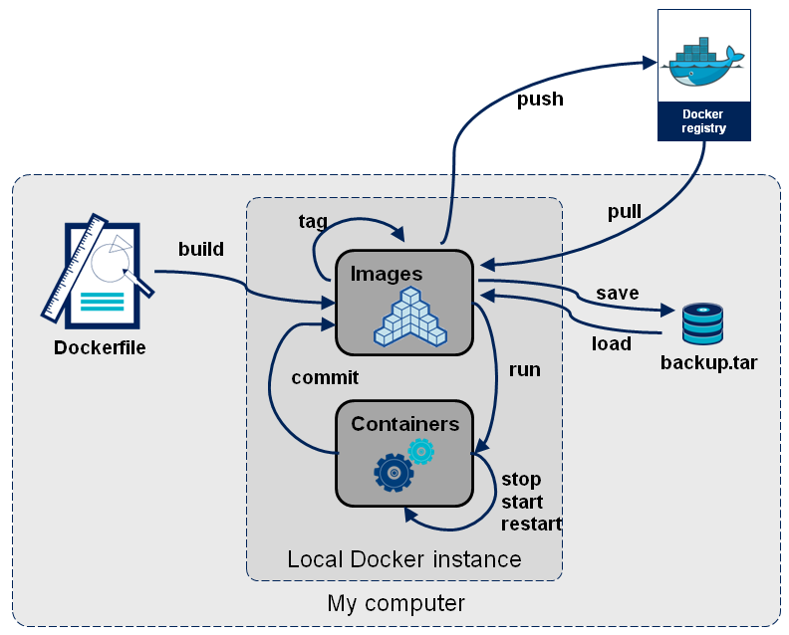
Docker Container Lifecycle ……
• The Life of a Container
– Conception
• BUILD an Image from a Dockerfile
– Birth
• RUN (create+start) a container
– Reproduction
• COMMIT (persist) a container to a new image
• RUN a new container from an image
– Sleep
• KILL a running container
– Wake
• START a stopped container
– Death
• RM (delete) a stopped container
• Extinction
– RMI a container image (delete image)

Slide 50
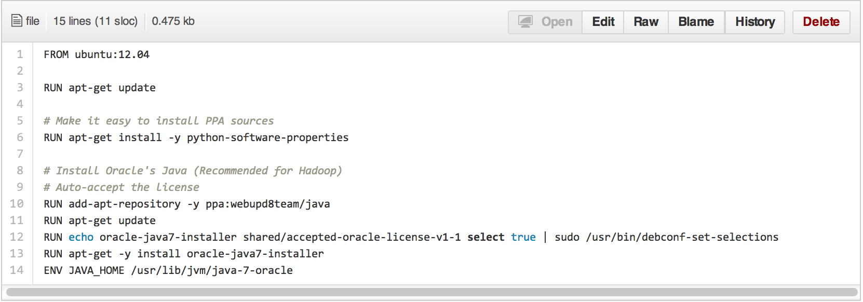
Dockerfile ……
• Like a Makefile (shell script with keywords)
• Extends from a Base Image
• Results in a new Docker Image
• Imperative, not Declarative
A Docker file lists the steps needed to build an images
• docker build is used to run a Docker file
• Can define default command for docker run, ports to expose, etc

Slide 51
https://docs.docker.com/engine/installation/windows/
Thank you

